Slide 1
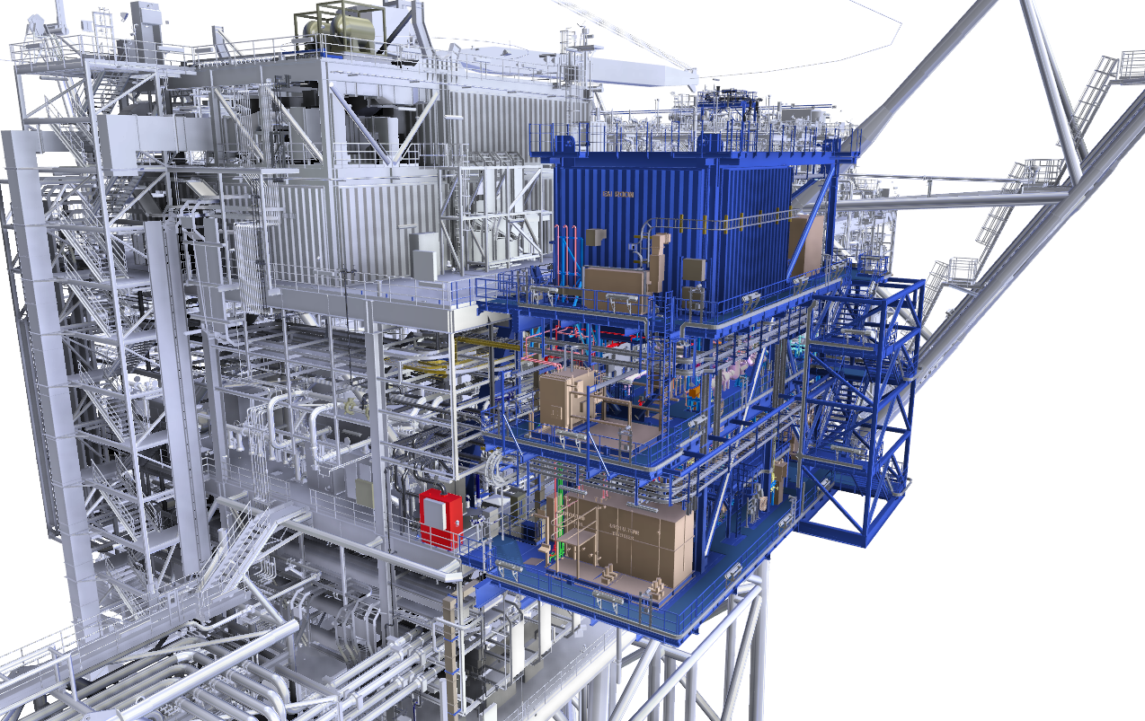
E&I ROOM
HPU
HVAC AIR HANDLING UNIT
Chemical Injection Package
(Scale Inhibitor)
Chemical Injection Package
(Antifoam & Asphaltene)
Module Isometric View
Looking North East

Slide 2
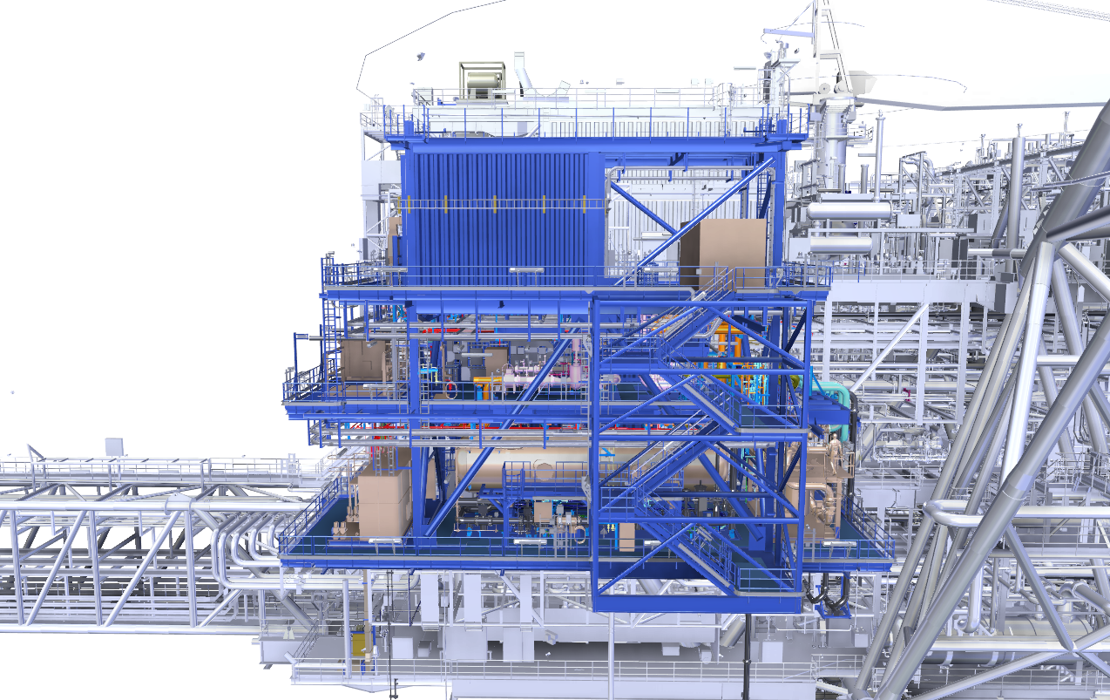
Module
Looking North
E&I ROOM
HPU
Chemical Injection Package
(Scale Inhibitor)
PRODUCED WATER TREATMENT PACKAGE
Chemical Injection Package
(Antifoam & Asphaltene)
SLUGCATCHER

Slide 3
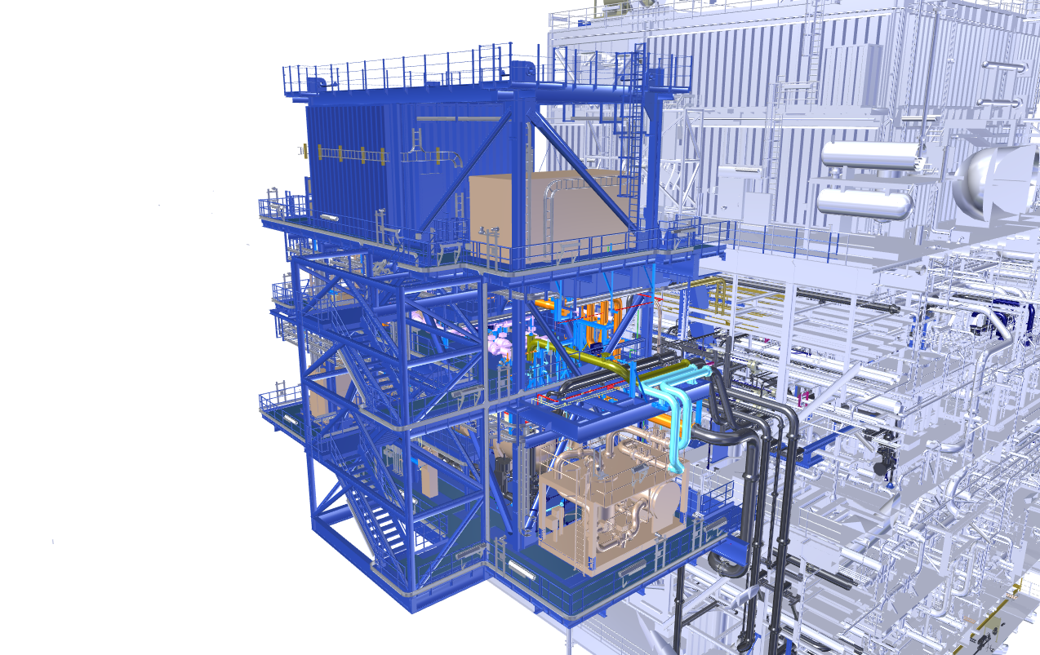
E&I ROOM
HPU
PRODUCED WATER TREATMENT PACKAGE
Module Isometric View
Looking North West

Slide 4
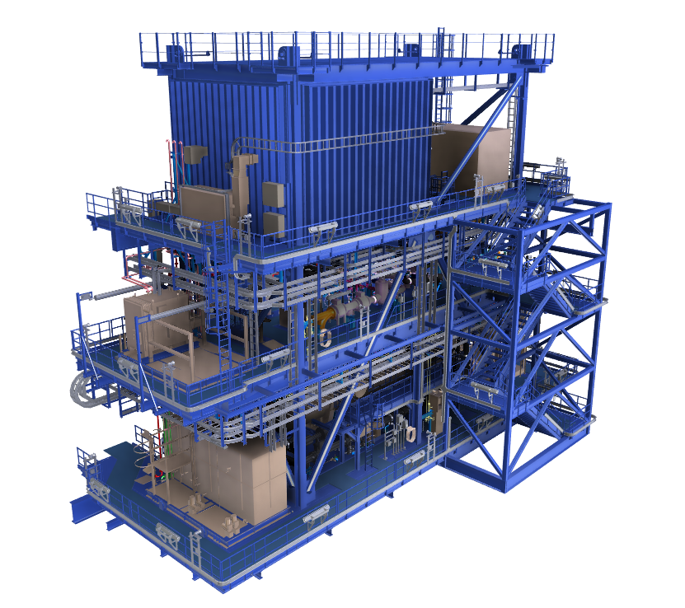
E&I ROOM
HPU
HVAC AIR HANDLING UNIT
Chemical Injection Package
(Scale Inhibitor)
Chemical Injection Package
(Antifoam & Asphaltene)
Module Isometric View
Looking North East

Slide 5
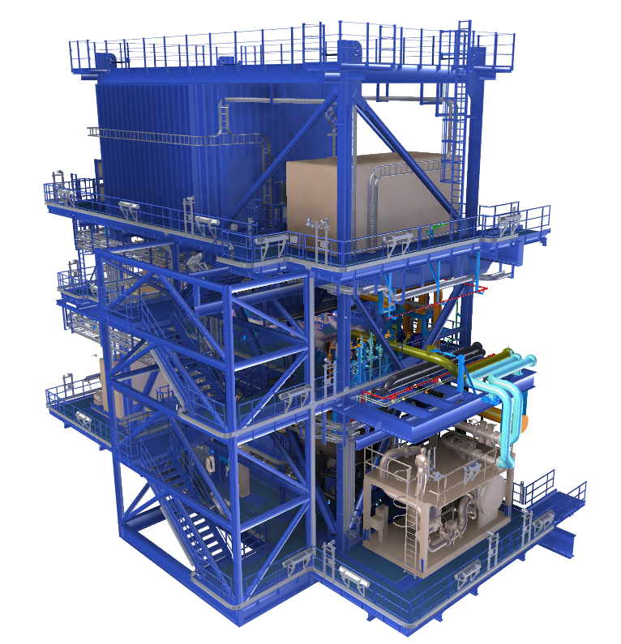
E&I ROOM
HPU
PRODUCED WATER TREATMENT PACKAGE
Module Isometric View
Looking North West

Slide 6
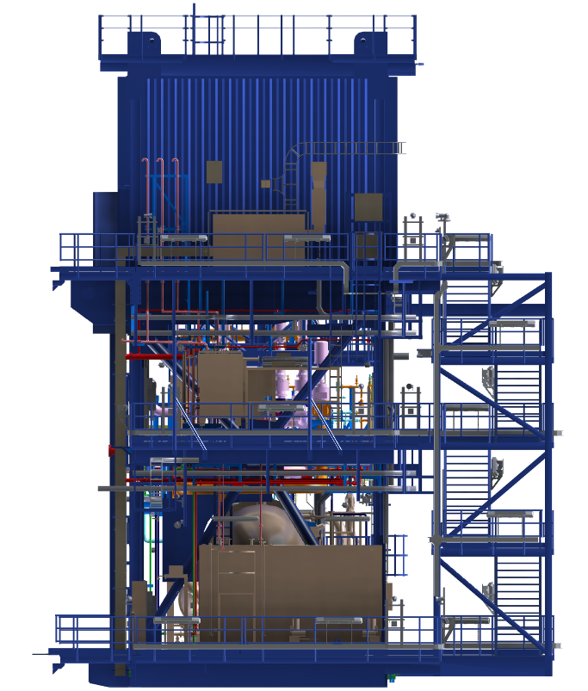
E&I ROOM
HVAC AIR HANDLING UNIT
Chemical Injection Package
(Scale Inhibitor)
Chemical Injection Package
(Antifoam & Asphaltene)
Module Ortho View
Looking East

Slide 7
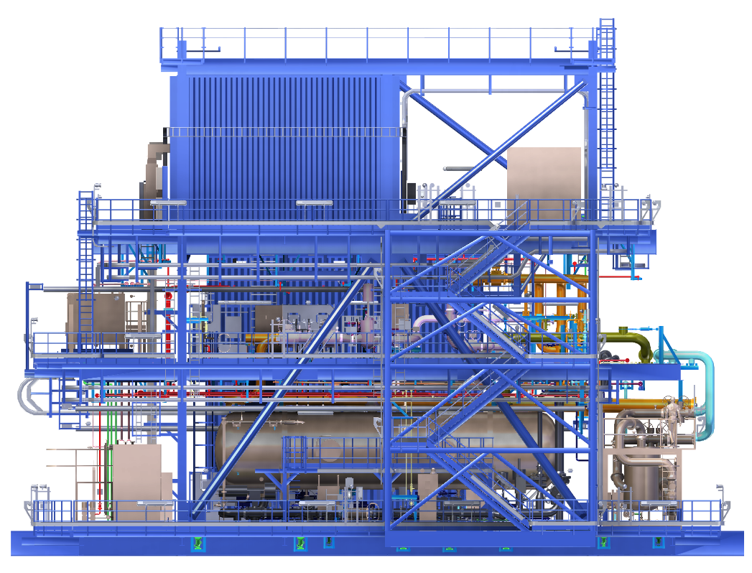
Module Ortho View
Looking North
E&I ROOM
HPU
Chemical Injection Package
(Scale Inhibitor)
Chemical Injection Package
(Antifoam & Asphaltene)
SLUGCATCHER
PRODUCED WATER TREATMENT PACKAGE

Slide 8
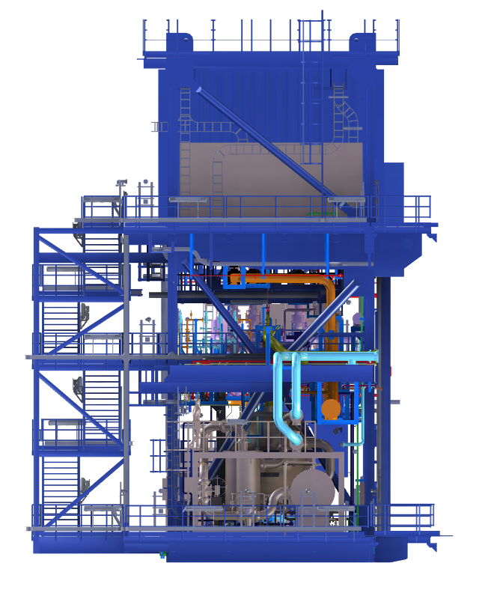
E&I ROOM
HPU
PRODUCED WATER TREATMENT PACKAGE
Module Ortho View
Looking West

Slide 9
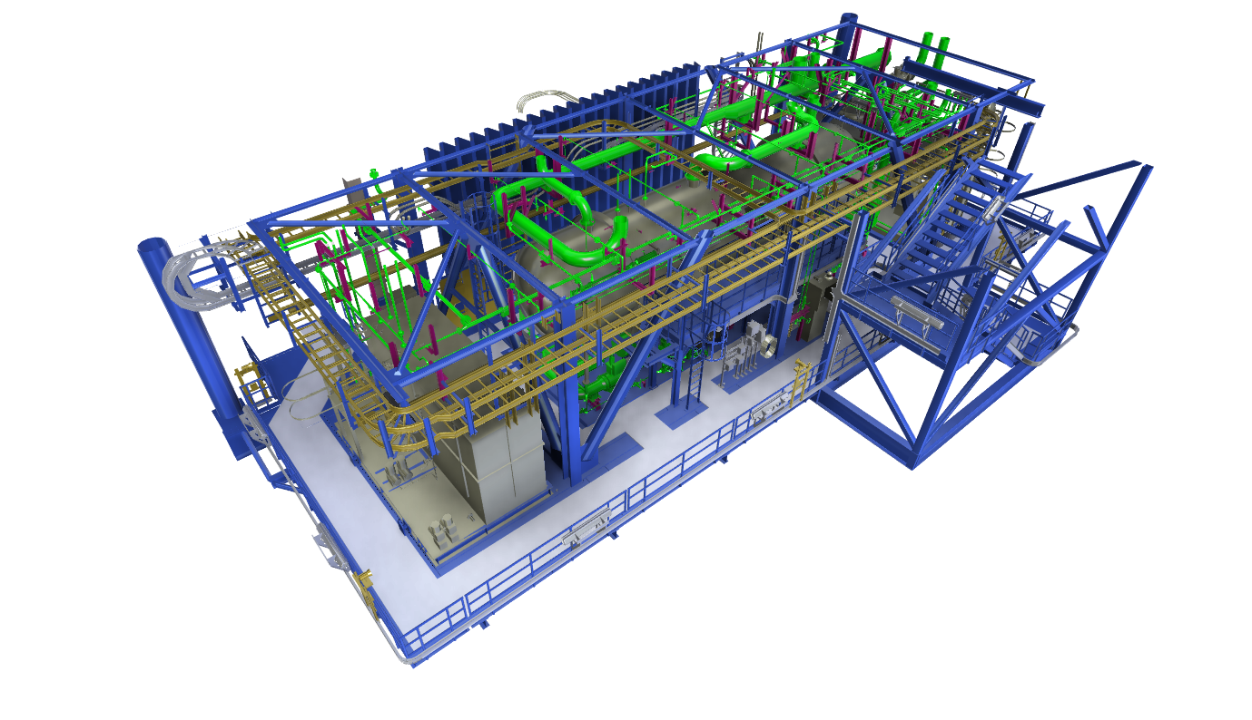
PRODUCED WATER TREATMENT PACKAGE
SLUGCATCHER
Chemical Injection Package
(Antifoam & Asphaltene)
Module Level 1 Section
Looking North East

Slide 10
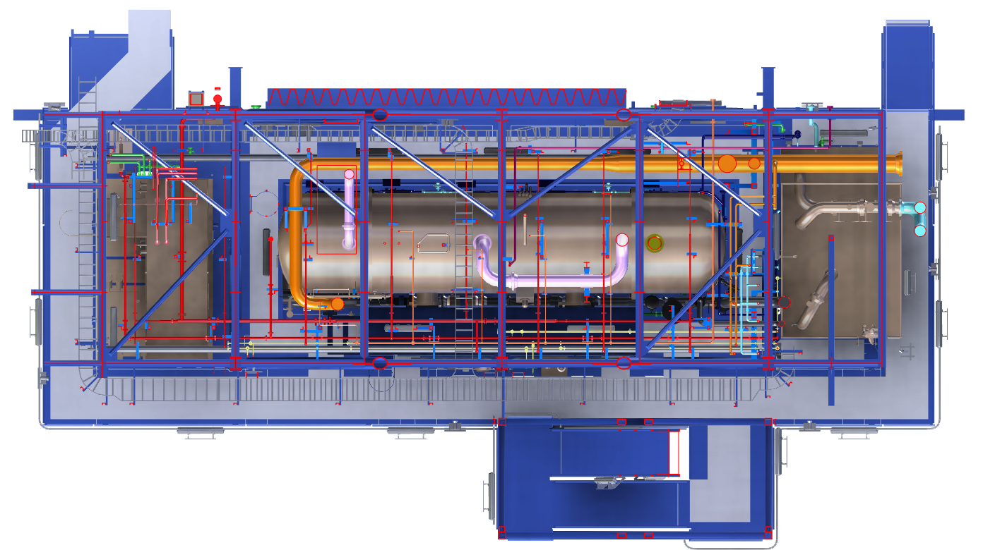
Module Level 1 Section
Plan North
SLUGCATCHER
Chemical Injection Package
(Antifoam & Asphaltene)
PRODUCED WATER TREATMENT PACKAGE

Slide 11
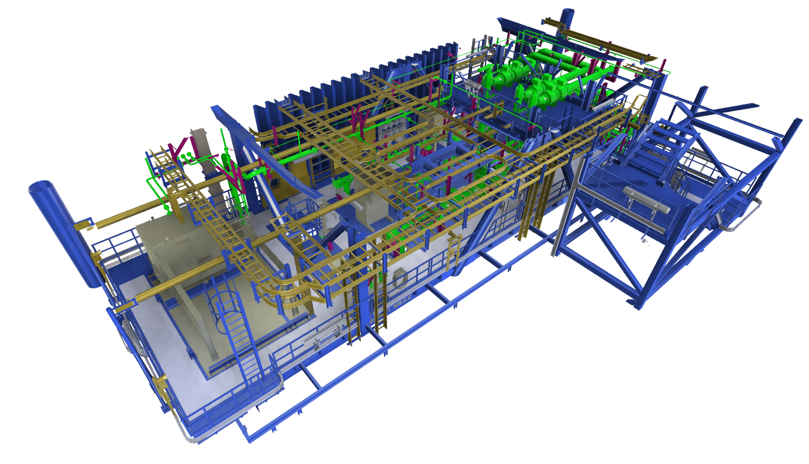
Chemical Injection Package
(Scale Inhibitor)
Module Level 1 Mezz Section
Looking North East

Slide 12
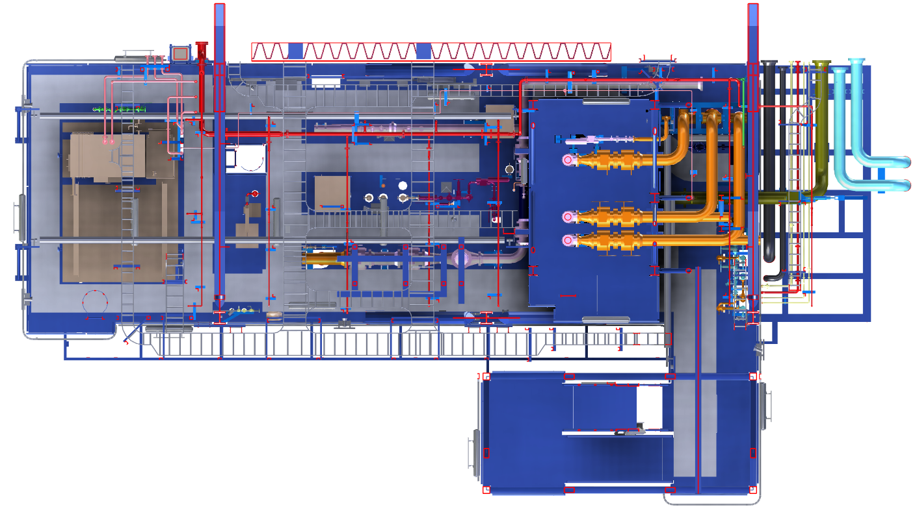
Chemical Injection Package
(Scale Inhibitor)
Module Level 1 Mezz Section
Plan North

Slide 13
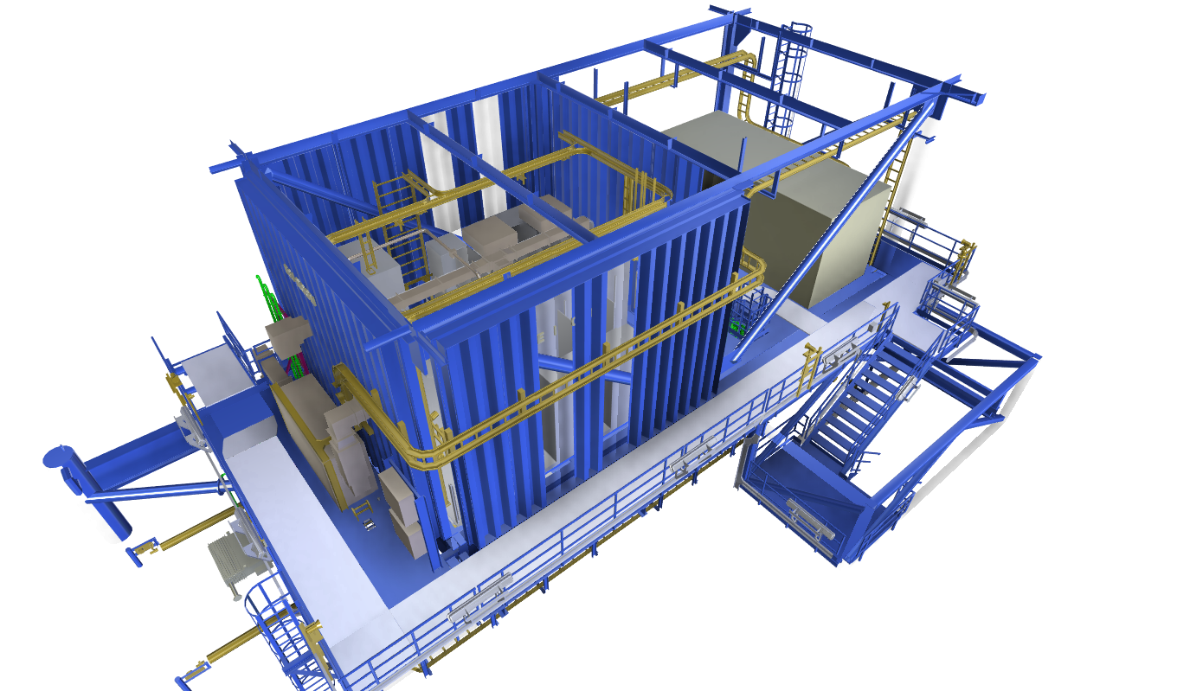
HPU
E&I ROOM
HVAC AIR HANDLING UNIT
Module Level 2 Section
Looking North East

Slide 14
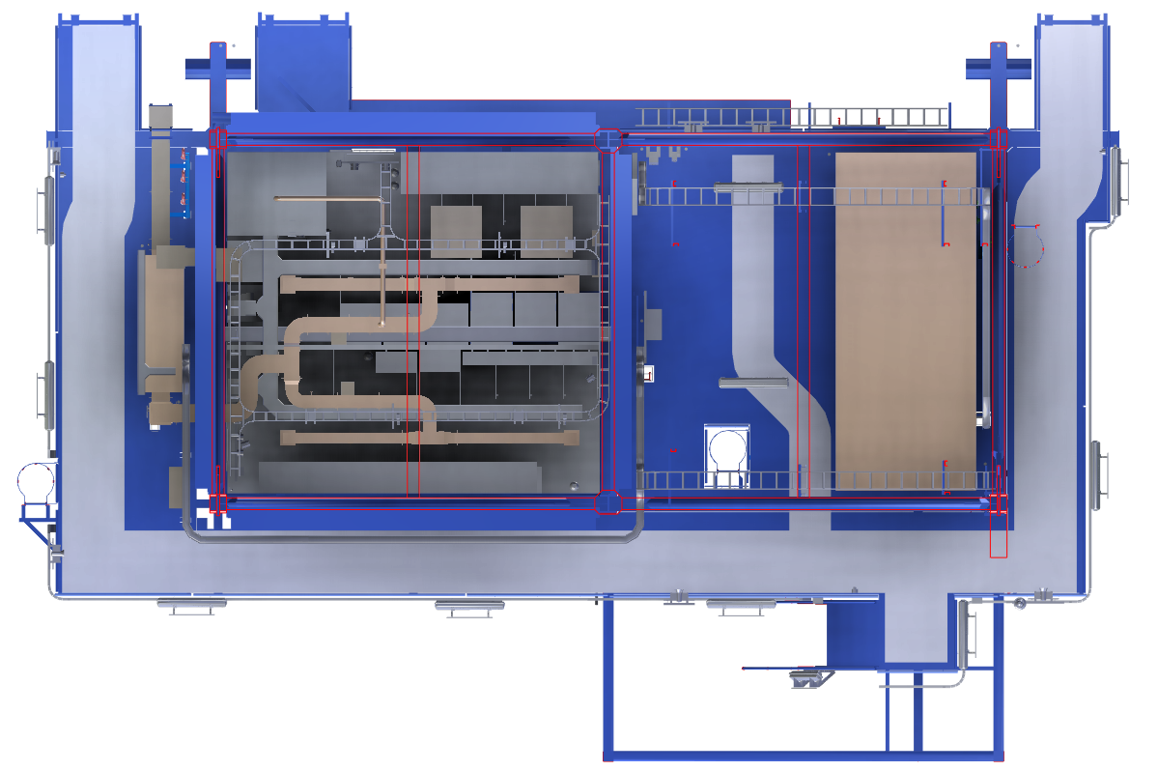
HVAC AIR HANDLING UNIT
E&I ROOM
HPU
Module Level 2 Section
Plan North

Slide 15
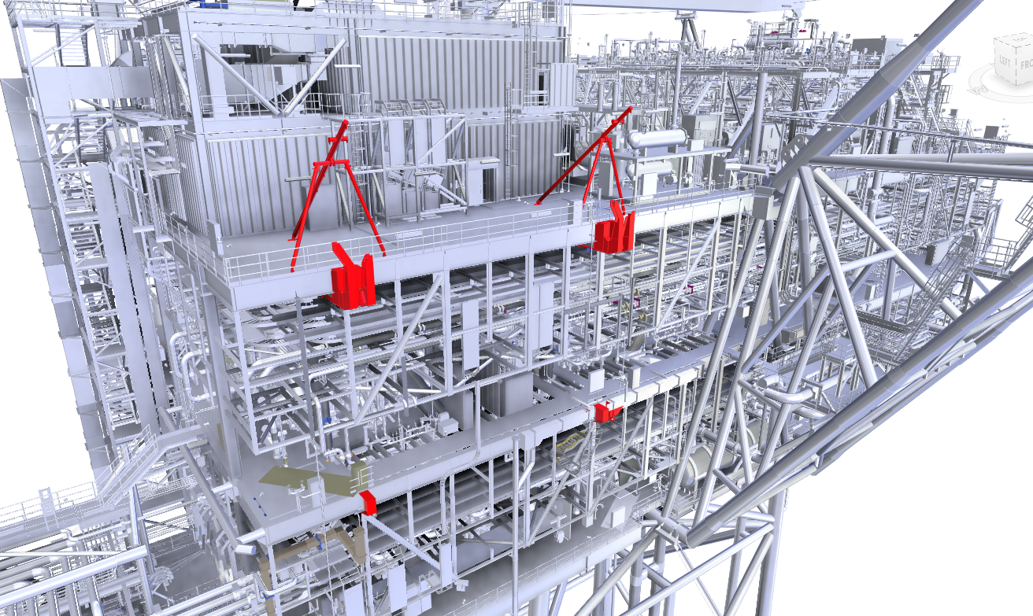
TRIPODS ERECTED TO ALLOW HOOK INSTALL
MODULE HOOKS
COMPRESSION STOPS
Hook Installation
Looking North East

Slide 16
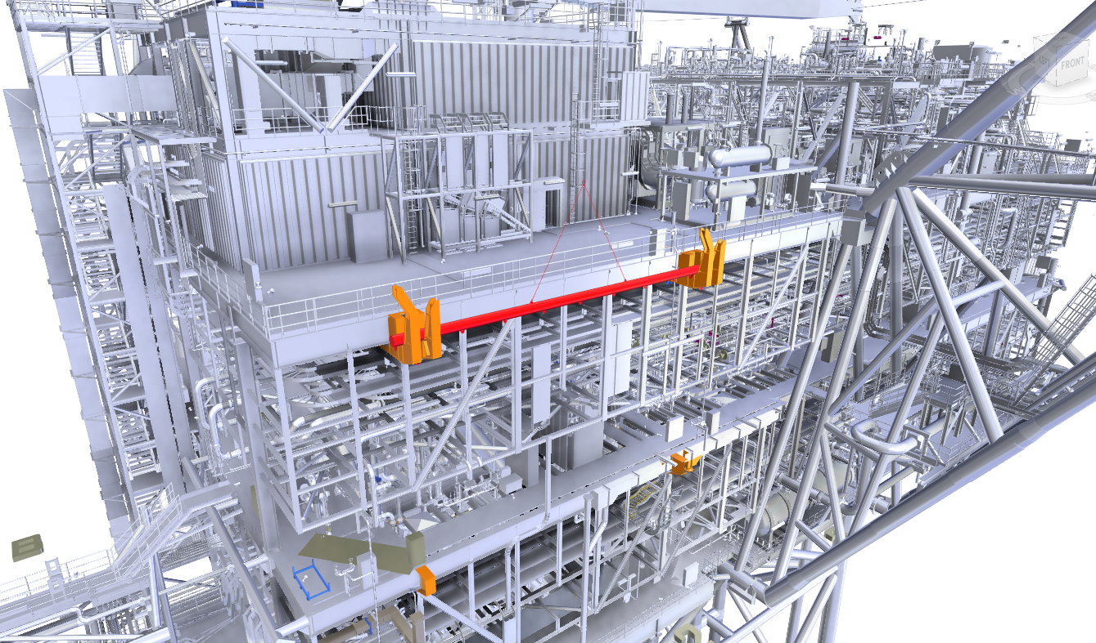
SPREADER BAR
Spreader Bar Installation
Looking North East

Slide 17
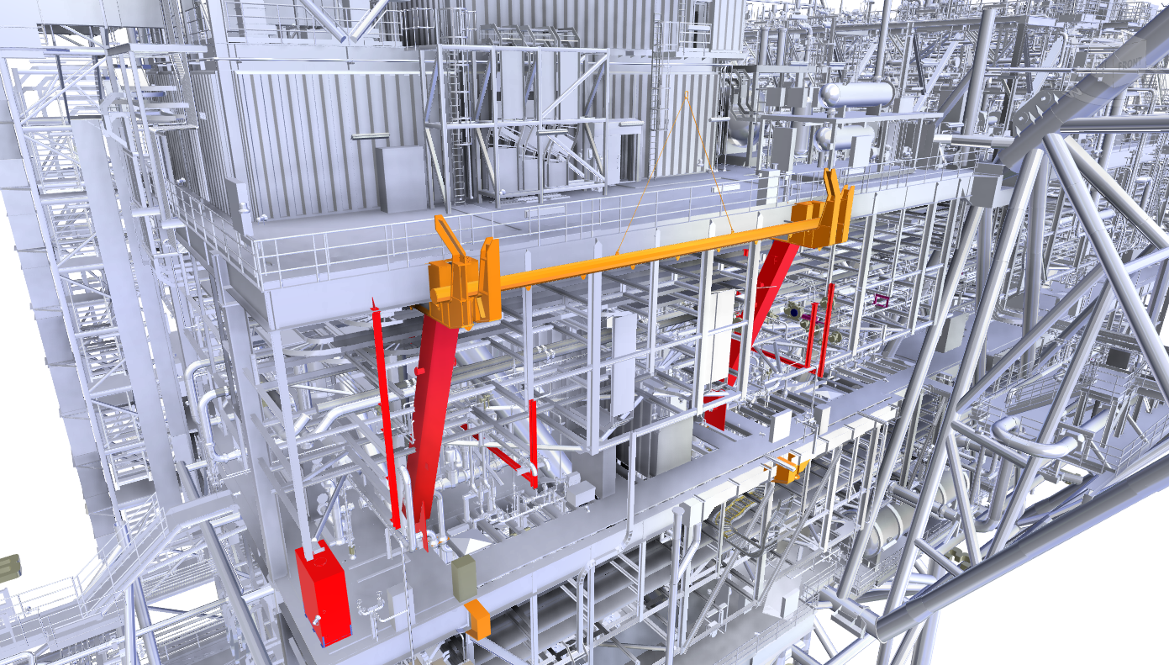
SPREADER BAR USED TO AID BRACE INSTALL
ADDITIONAL STRENGTHENING BRACES
Brace Installation
Looking North East

Slide 18
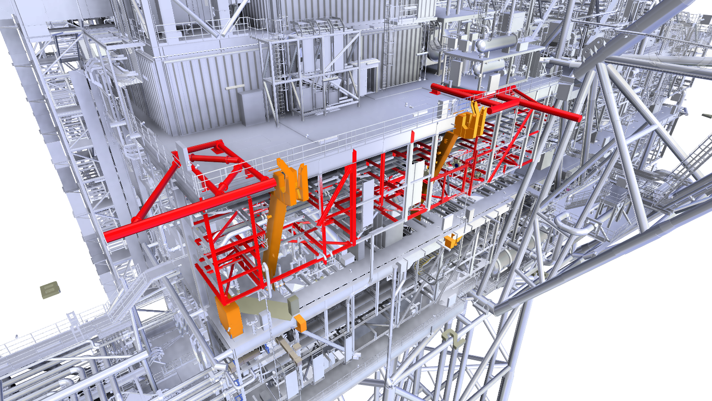
MODULE INSTALLATION GUIDES
EXISTING PIPE RACK MODS
Bumper Bars and
Pipe Rack Installation
Looking North East

Slide 19
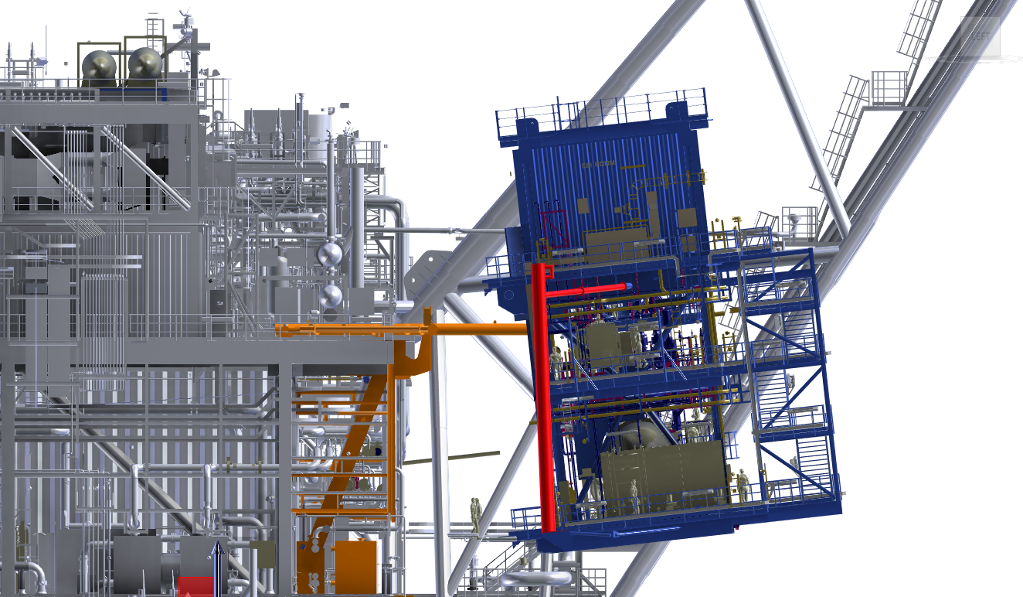
MODULE BUMPER BARS
Module Installation
Looking East

Slide 20
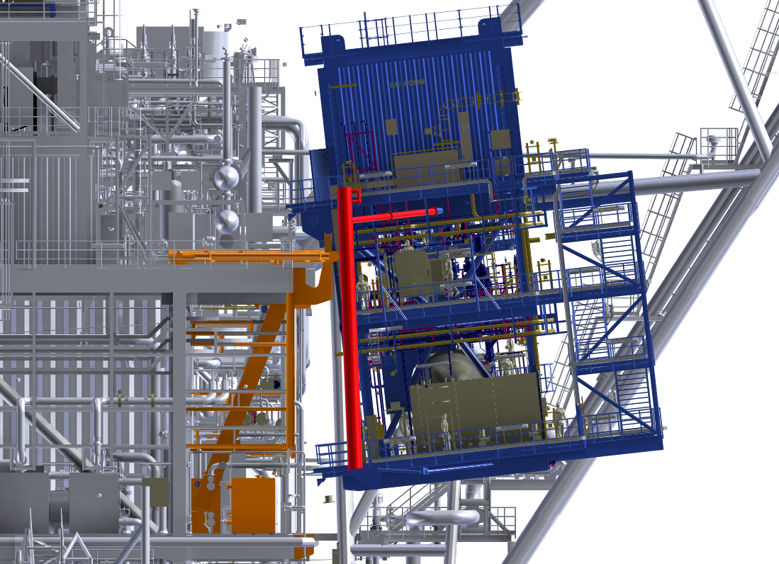
MODULE BUMPER BARS ENGAGE ON NORTH/SOUTH GUIDES
Module Installation
Looking East

